Slide 1
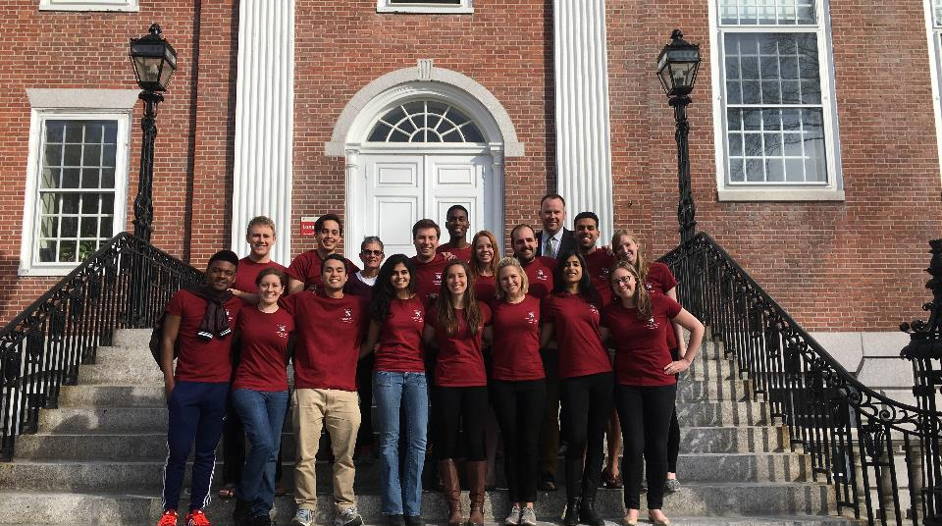

HGSE Student Council
Information Session
August 2019

Slide 2

Introducing HGSE Student Council
What is Student Council?
  Leadership opportunity to represent student body to shape HGSE student experience
HGSE Student Council Information Session | August 2019

Slide 3
Student Council Core Functions
Improving the quality of students’ academic, professional, social, and personal development while at HGSE;
Acting as liaison between the students and the faculty/administration;
Advocating for the incorporation of student views and opinions in the formulation of policies and procedures governing HGSE and Harvard University; and
Promoting and funding student-initiated academic, professional, personal development and social programs.
HGSE Student Council Information Session | August 2019

Slide 4
Student Council Positions
15-18 Program Senators elected by their cohort
  One senator per masters degree program (13)
  One or two senators per doctoral program (2-4)
  One senator from the Certificate of Advanced Study (CAS) program
1 Voting Member of Harvard Graduate Council elected at-large by whole student body (1)
All Officer positions are elected from within the Student Council
  Executive Chair & Vice Chair
  3 Committee Chairs: Programming & Events; Communications & Outreach; Student Advocacy & Issues
HGSE Student Council Information Session | August 2019

Slide 5
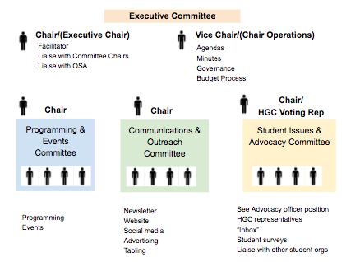
Overview of Student Council Structure
HGSE Student Council Information Session | August 2019

Slide 6
Key Responsibilities
**Encourage you to review Constitution & Bylaws on website.
Attend weekly Council Meetings
  Follow-up with your cohorts
Fulfill your committee obligations
  Determined by you and your Committee Chair
If run for Committee Chairs – additional responsibilities
If HGC Rep – additional responsibilities
BUT really…depends how much you volunteer for, want to lead
HGSE Student Council Information Session | August 2019

Slide 7
Examples of Recent Student Council Programs and Initiatives
Academic Programs
  Breakfast, Lunch, and Tea (BLTs) with faculty
  Free Speech and Safe Spaces discussion forum
  EdTALKS
Social Programs
  HGSE Yule Ball
  HGSE Field Day
  Volunteering
Advocacy Initiatives
  Meetings with Dean
  Supporting HGC Response to executive order on immigration
  Advocating on issues of Information Technology
HGSE Student Council Information Session | August 2019

Slide 8
Student Council Committees
Committee | Key Responsibilities
Executive Committee | Coordination of Student Council meetings and governance; engagement with admin, faculty, and staff; and liaising with OSA
Programming & Events Committee | Coordinating academic, social, and wellness activities and programs
Communications & Outreach Committee | Coordinating communication between the Student Council and the student body
Student Advocacy & Issues Committee | Ascertaining student opinion and concern on academic, social matters, and community issues and leading conversations about potential action to advocate on behalf of students
HGSE Student Council Information Session | August 2019

Slide 9
Student Council Election Timeline
Nomination period: Now – August 30th @ 12 noon
General Elections: Friday, August 30th through Tuesday, September 3rd
Fall Retreat: September 7th 9am-2pm
First Meeting/Officer Elections: September 12
HGSE Student Council Information Session | August 2019

