Slide 1
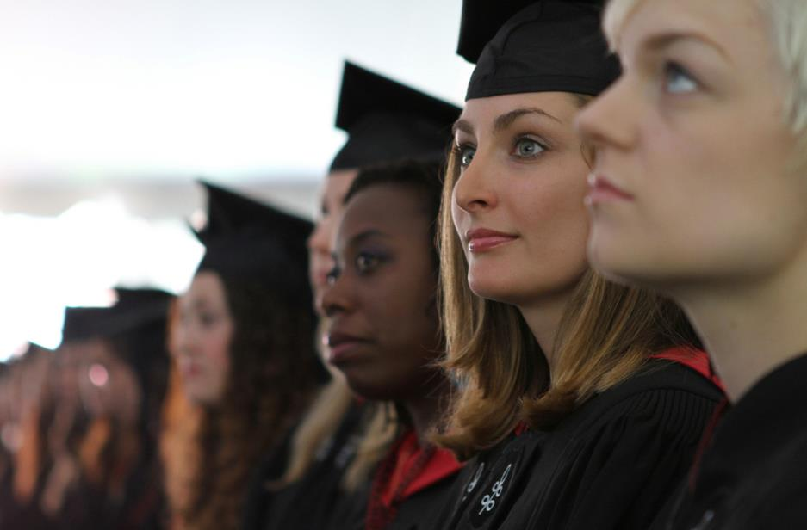
Commencement 2016

Slide 2
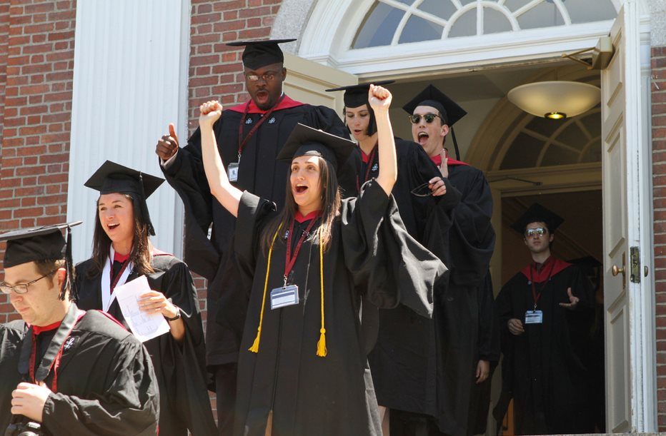
Congratulations!

Slide 3
Tuesday, May 24
International Students Reception
3:00 – 4:30 p.m. Gutman Conference Center
Showcase of Diversity & Inclusive Excellence:
2015 - 2016 Student Contributions
4:30 - 6:00 p.m. Gutman Reading Area

Slide 4
Wednesday, May 25
Breakfast for Graduating Ed.D. & Ed.L.D. Students 8:30 – 9:30 a.m. Radcliffe Yard
Robing Ceremonies for Graduating Ed.D. Students 10:00 a.m. – 12:00 p.m. Askwith Hall & GCC
Ed.L.D. Celebration Ceremony
1:00 – 3:00 p.m. Askwith Hall
C.A.S. Cording Ceremony
1:00 – 3:00 p.m. Gutman Reading Area

Slide 5
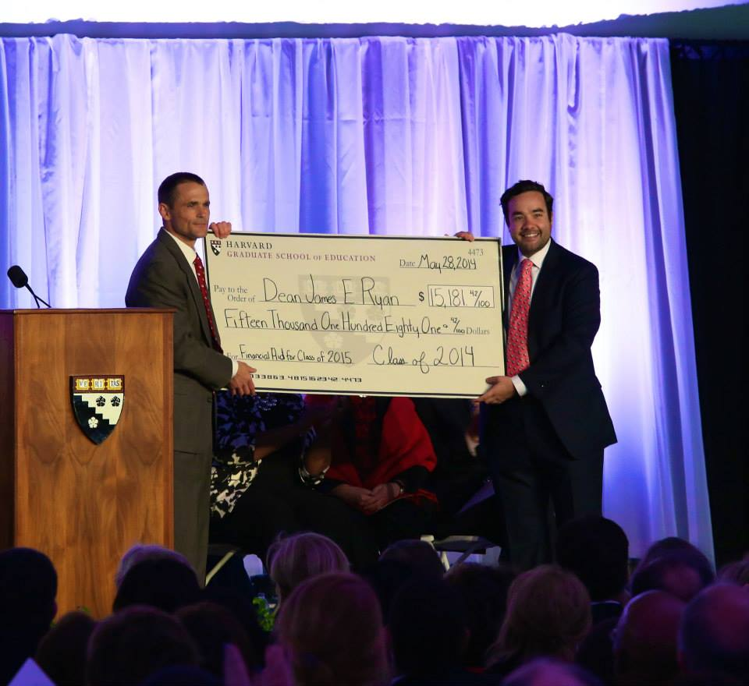
Wednesday, May 25
HGSE Convocation
3:30 – 5:00 p.m. Radcliffe Yard
Dean Ryan’s Address
Class gift
Teaching award
Intellectual contribution/faculty tribute awards
Class Marshals
Strimling award
Student speech
Faculty speech
Guest speaker:
Freeman Hrabowski

Slide 6
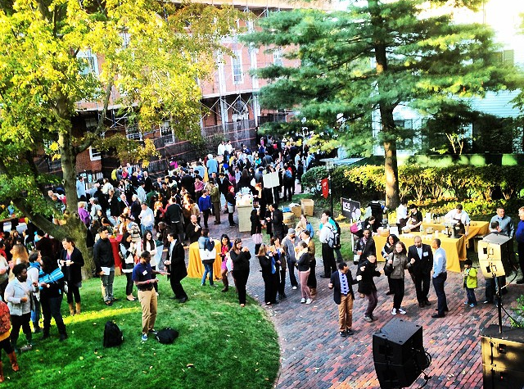
Wednesday, May 25
Block Party!
5:00 – 7:00 p.m. Appian Way

Slide 7
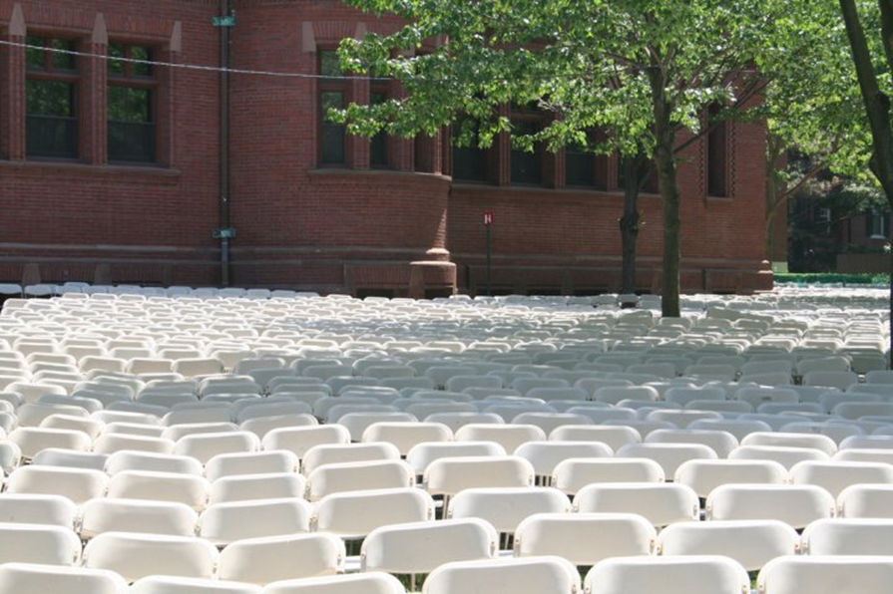
Thursday, May 26: C-Day!
6:45 a.m. Harvard Yard (Gates open for guests)
Ceremony simulcast under HGSE tent in Radcliffe Yard starts at 9:00 a.m.

Slide 8
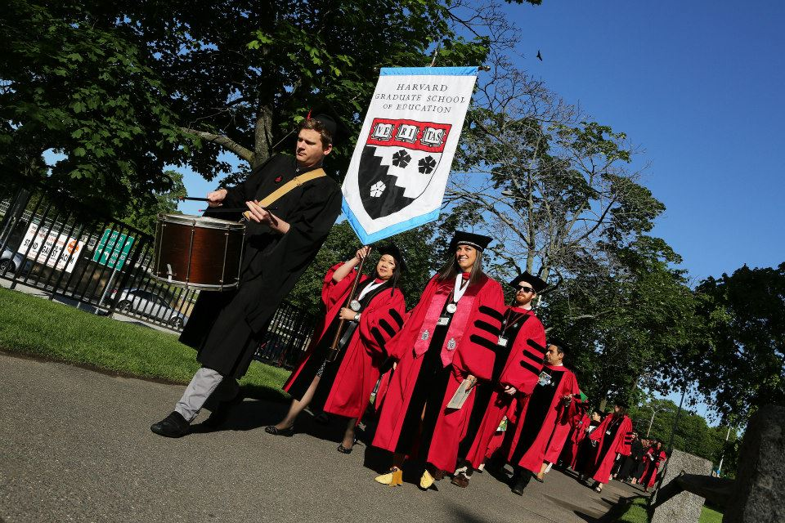

Thursday, May 26
HGSE Academic Processional
7:30 a.m. Appian Way
No children allowed to process into Tercentenary Theatre

Slide 9
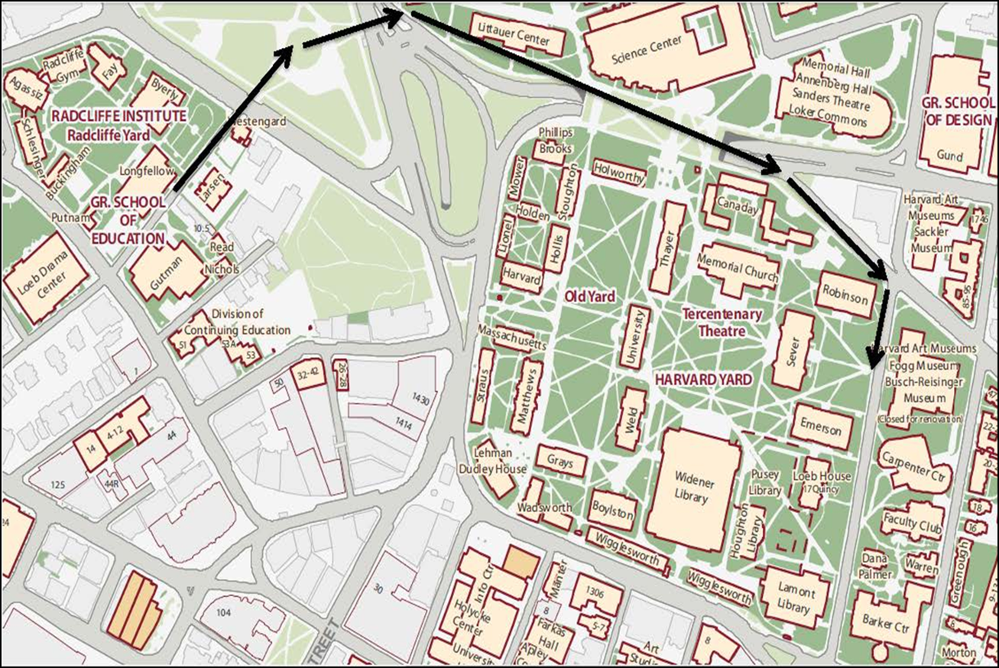
Academic Processional
No Strollers allowed in processional

Slide 10
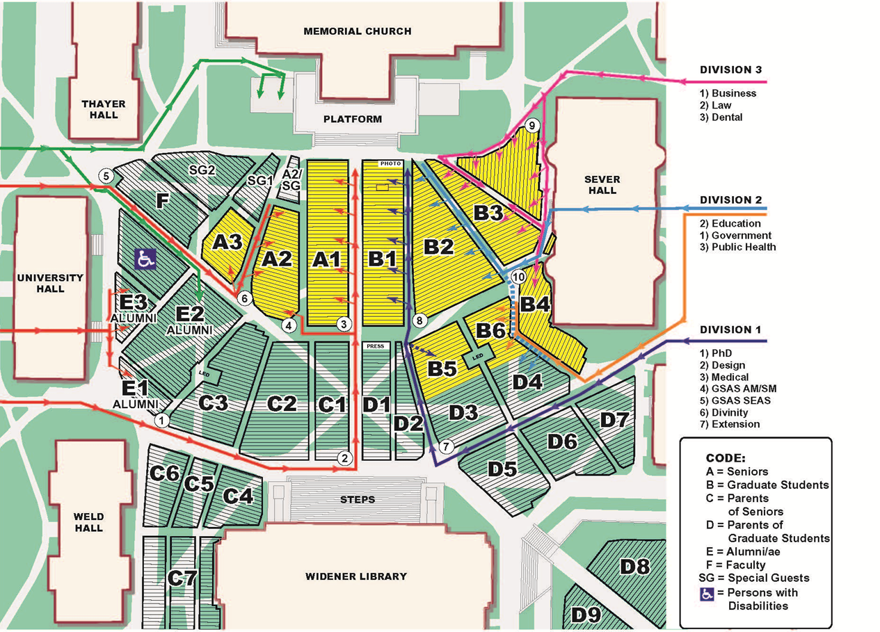
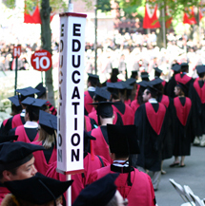
Tercentenary Theatre

Slide 11
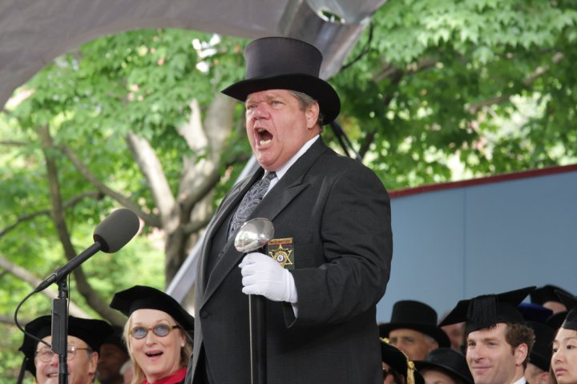
Entrance to Harvard Yard
Appropriate Regalia: Robe, hood, cap.
Lanyard.
Harvard ID

Slide 12

Backpacks
“No backpacks of any type will be admitted. No bag or item larger than 12” x 12”x 12” will be permitted inside the Yard.” - HUPD

Slide 13
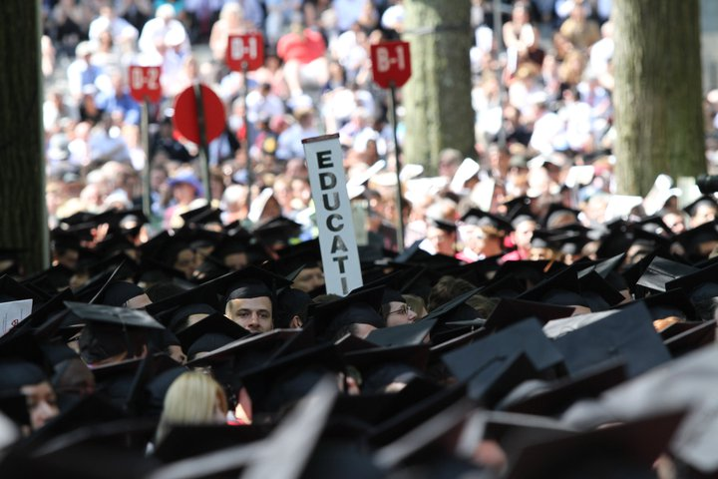
Morning Exercises
9:45 a.m. Harvard Yard
Graduates will not be awarded their diplomas here.

Slide 14
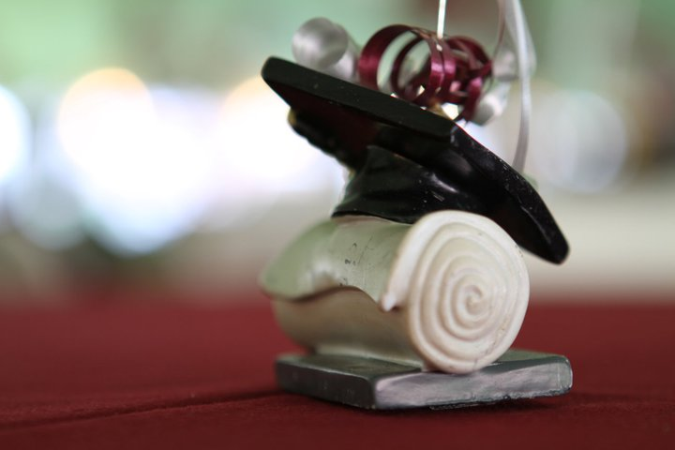
HGSE Diploma Ceremony
It is important that you return to HGSE, as quickly as possible, in order for our Diploma Ceremony to start on time.

Slide 15
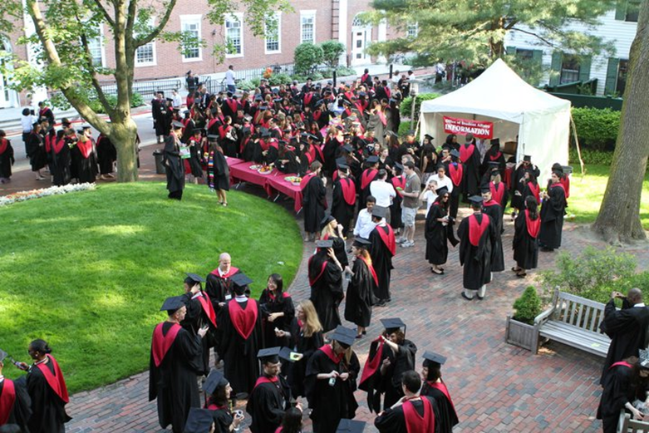
Meeting Locations
11:45 a.m. – 12:15 p.m. HGSE Campus
There will be signs posted on Appian Way, Longfellow Hall and Gutman Library

Slide 16
Meeting Locations
EAT: Food will be available
Use the restroom
Line-up in alphabetical order
*You will not return to the meeting
locations (they will not be locked)
do not leave any personal items behind.

Slide 17
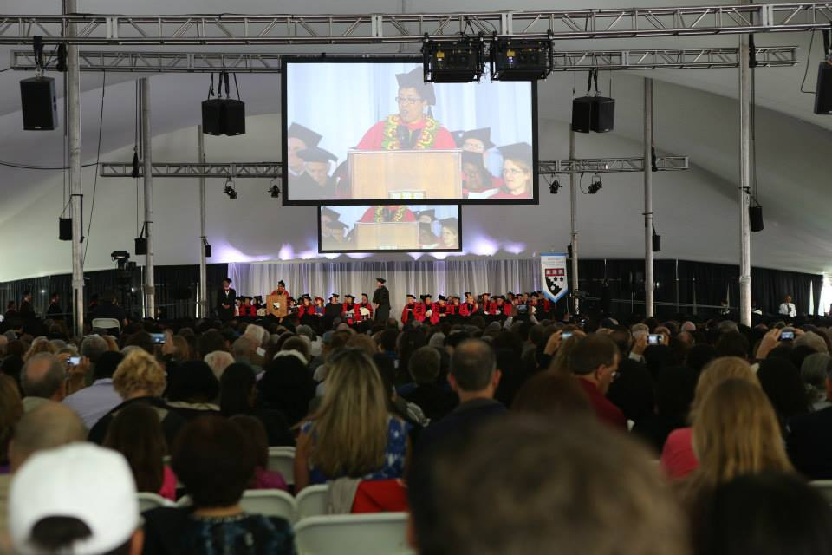
HGSE Diploma Ceremony
Guests may begin sitting under the tent at 9 a.m.

Slide 18
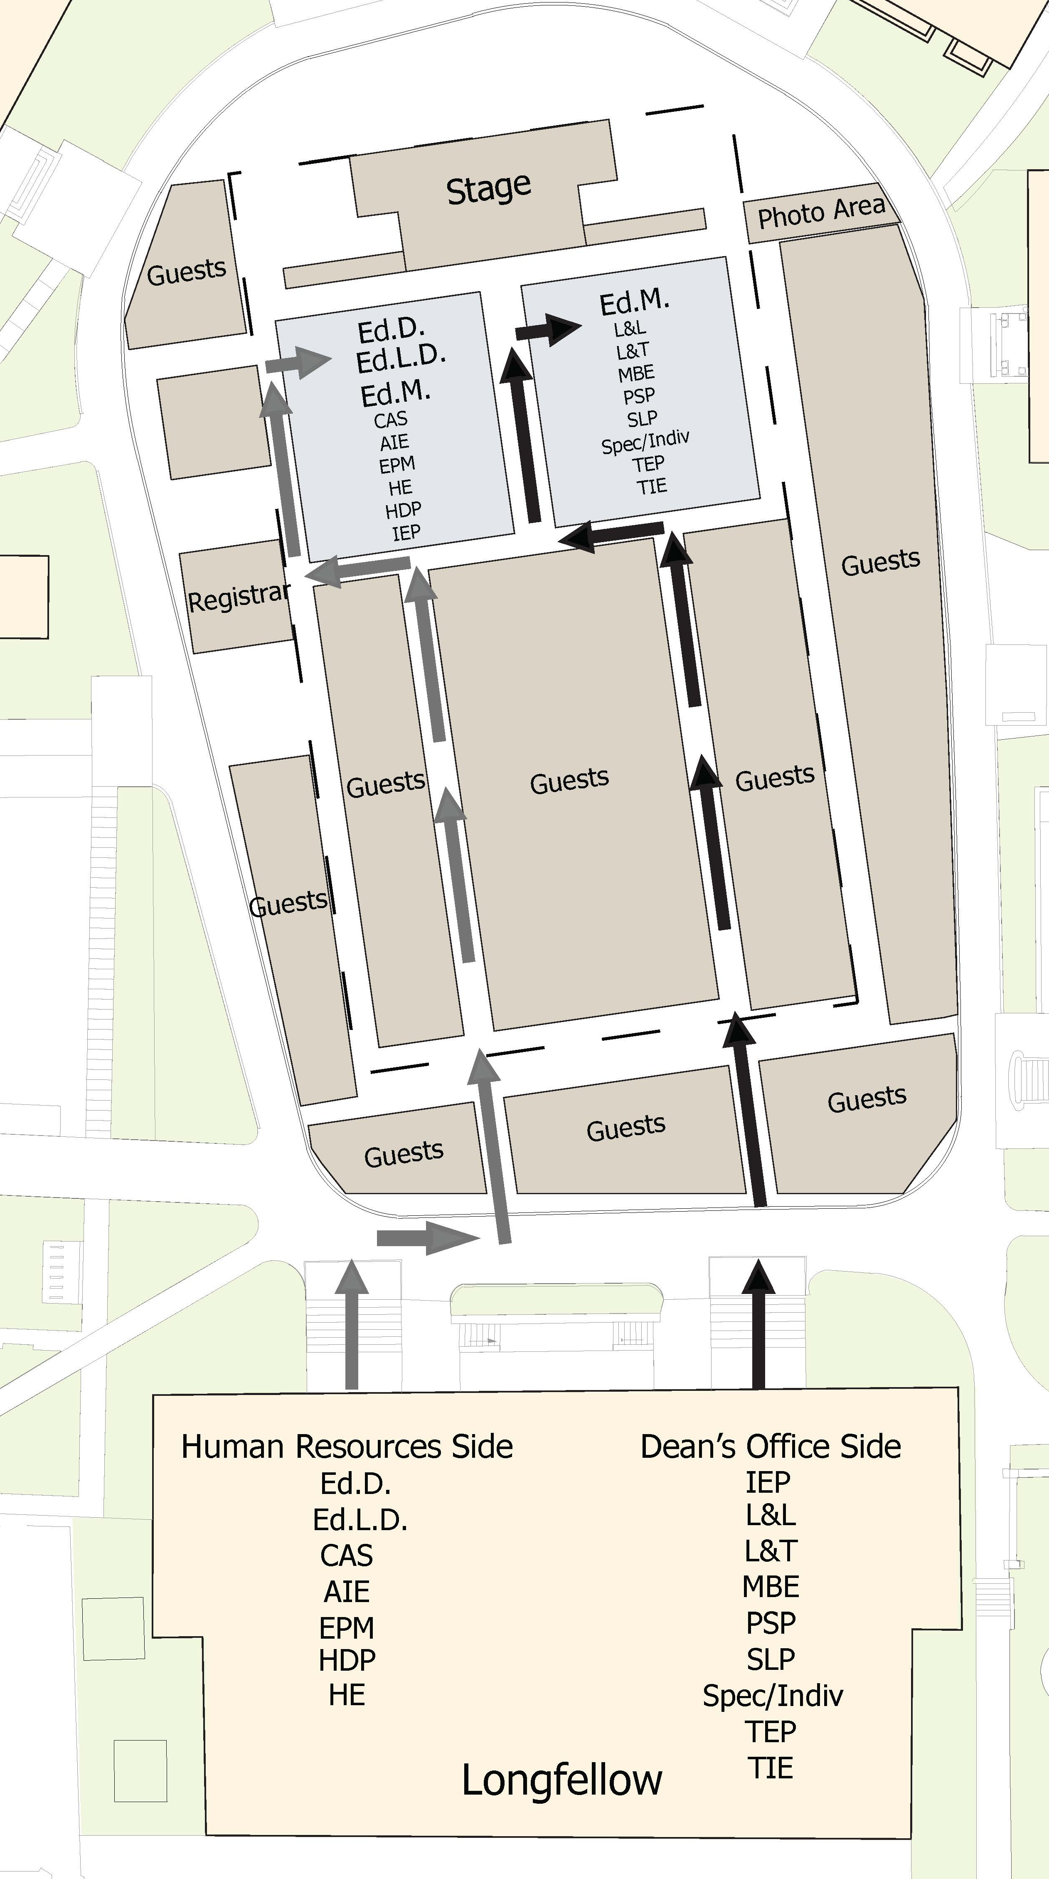
Processional
12:30 p.m. Radcliffe Yard
Graduates will process in alphabetical order by program, and in alphabetical order within their program.

Slide 19
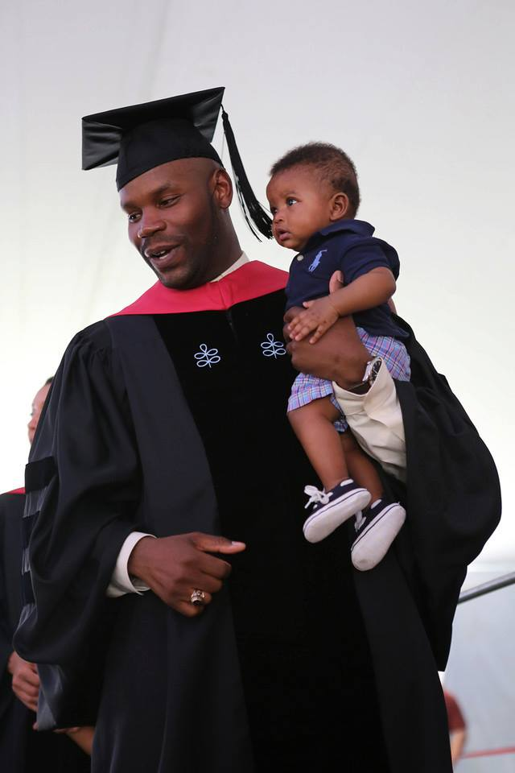
Children
Parents are welcome to walk across the stage with their children ☺

Slide 20
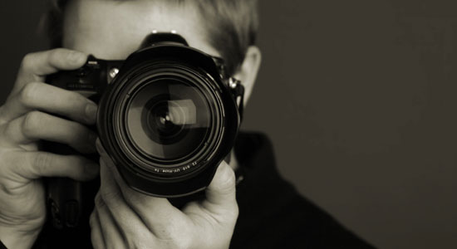
Photos
Students may purchase professional photos; Commencement Photos, Inc. will mail information directly.

Slide 21

University Alumni Exercises
2:30 p.m. Harvard Yard
Alumni procession
Address by President Faust
Commencement speaker Steven Spielberg

Slide 22
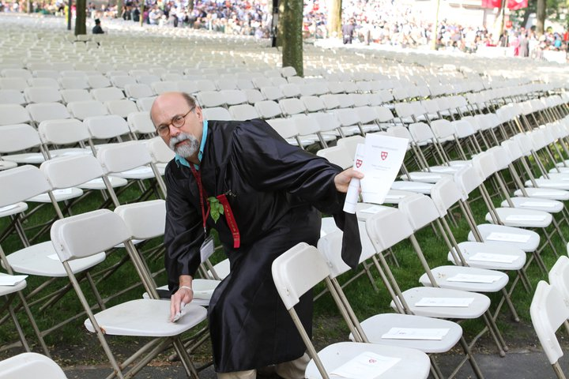
Tips!
Commencement happens, rain or shine.
The dye from regalia may bleed.
Wear comfortable shoes.
Be on time!

Slide 23
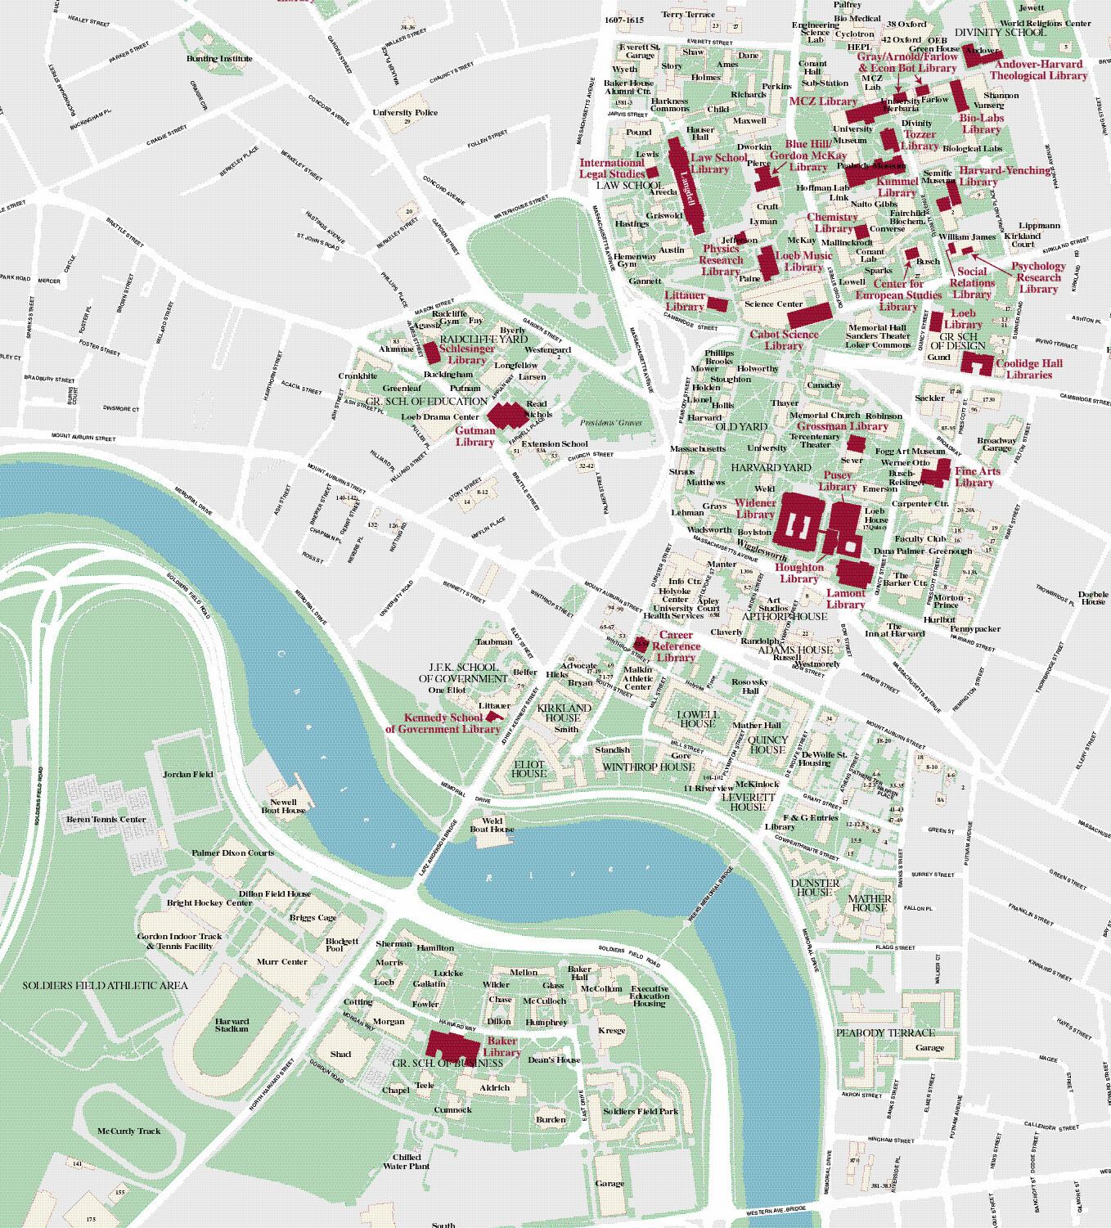

Parking
Available from 6:30 a.m. Wheelchair lift-equipped shuttles will be running until 8:00 p.m.
Harvard University Parking Services
Smith Campus Center 8th Floor
parking@harvard.edu
617-495-3772

Slide 24
Tickets
Two/graduate for HU Morning Exercises.
Three/graduate for HU Alumni Exercises.
No tickets required for any HGSE events.
Available in Gutman Library; May 16 - 26

Slide 25
Regalia
Pre-ordered
Available at the Harvard Coop May 19
*Additional $25 late fee
May 23 - 26

Slide 26
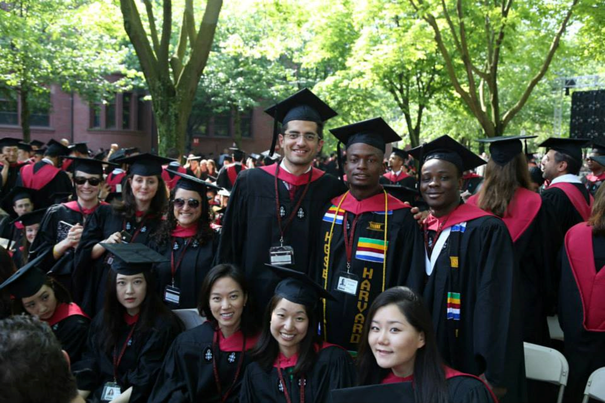
Master’s Regalia

Slide 27
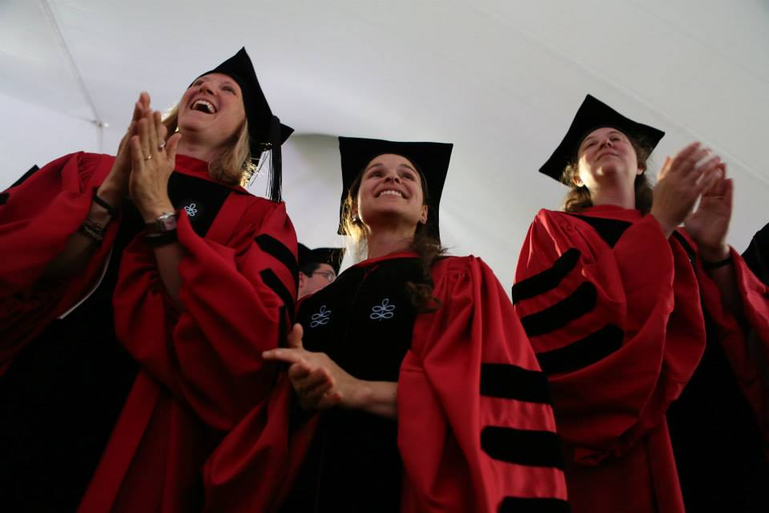
Ed.D. Regalia

Slide 28
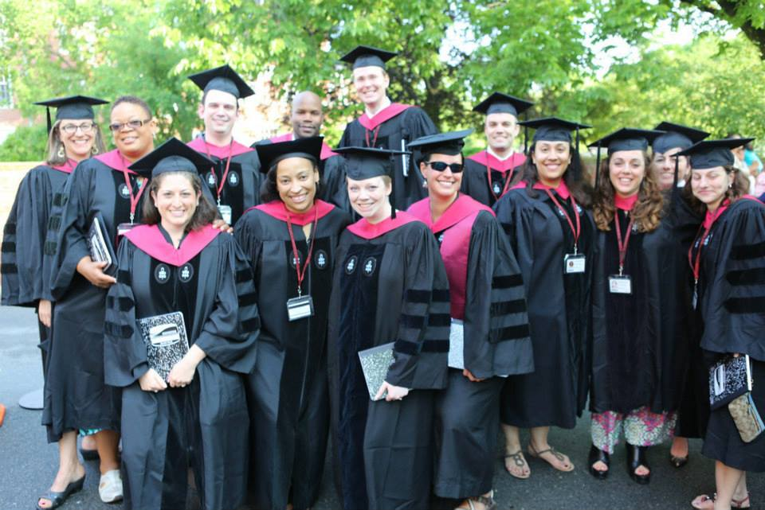
Ed.L.D. Regalia

Slide 29

Access & Disability Services
Students must request accommodations for both University and HGSE events, as part of the ticket
ordering poll.

Slide 30

Wheel Chairs
Belmont Medical Supplies
www.belmontmedical.com
185 Belmont St
Belmont, MA 02478
(617) 484-3888

Slide 31
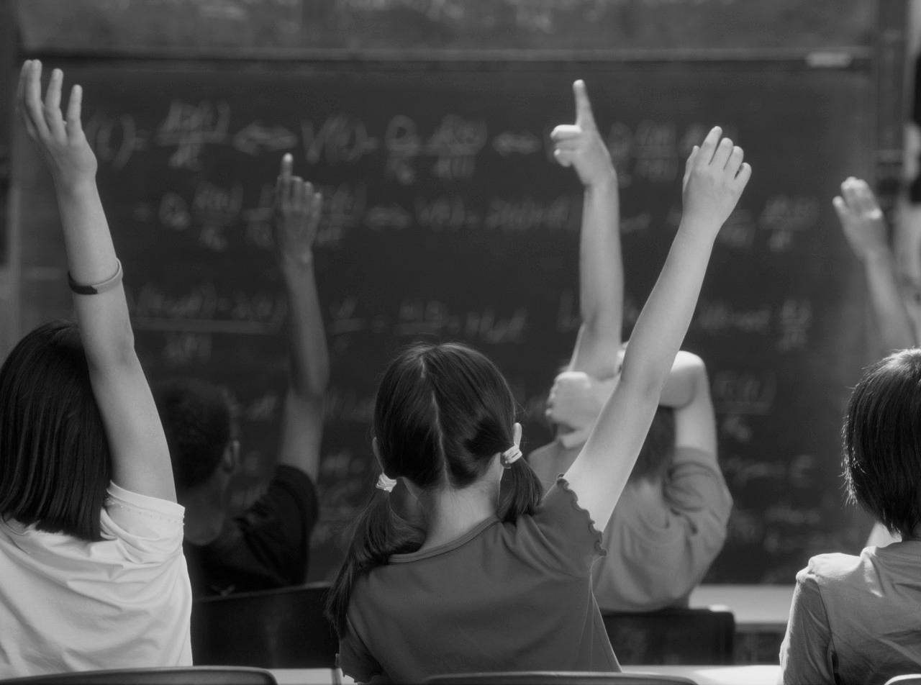
Questions?
Office of Student Affairs
Commencement isite
HGSE Weekly Newsletter
osa@gse.harvard.edu
617-495-8035

Slide 32
