Slide 1
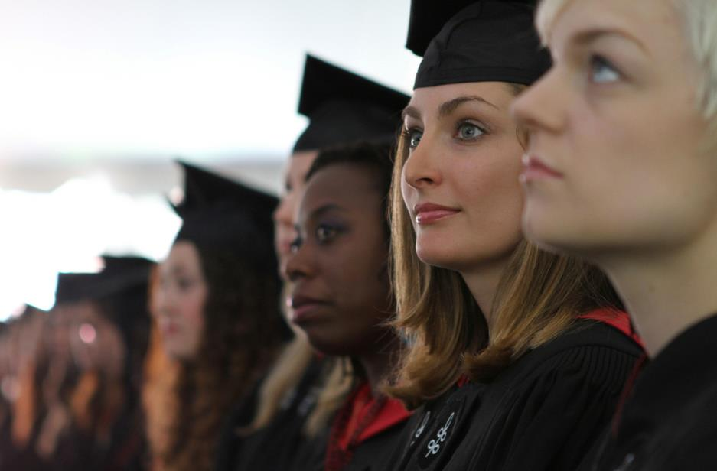
Commencement 2019

Slide 2
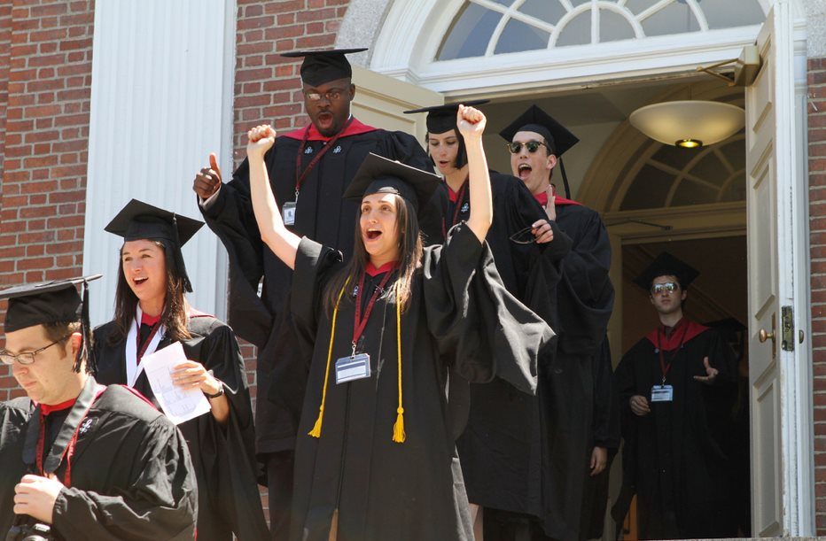
Congratulations!

Slide 3
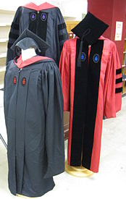
Regalia
Available at the Harvard Coop May 23 - 30
Missed the deadline?
Additional $25 late fee
Contact the Coop

Slide 4
Tickets
Thursday May 30th Harvard Yard
2 for HU Morning Exercises; 9 – 11:30 a.m.
2 for HU Alumni Exercises; 2:30 – 4 p.m.
Available in Gutman Library; May 20 – 29
*No tickets are required for the HGSE Diploma Ceremony in Radcliffe Yard; 12:30 – 2:30 p.m.

Slide 5
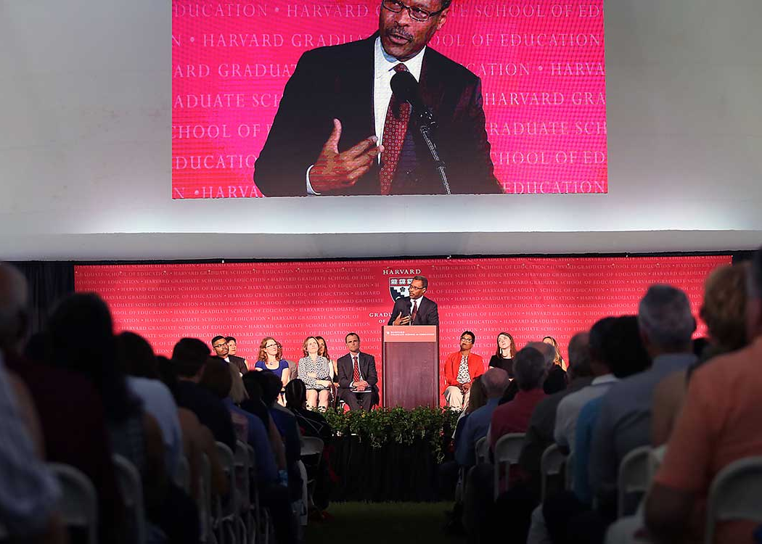
Wednesday, May 29
HGSE Convocation
3:30 – 5:00 p.m. Radcliffe Yard
Class gift
Class Marshals
Strimling award
Student speech
Faculty speech
HGSE Guest speaker
Teaching award
Intellectual contribution award
*No tickets required

Slide 6
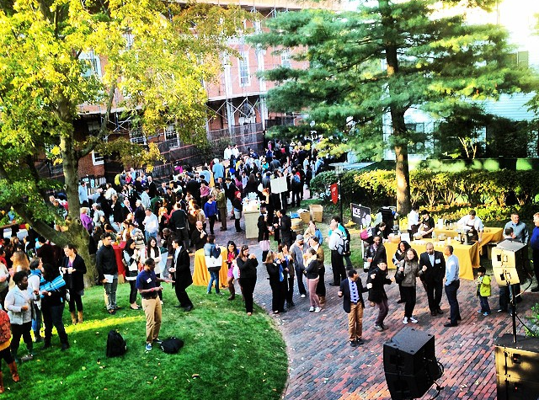
Wednesday, May 29
Block Party!
5:00 – 7:00 p.m. Appian Way

Slide 7
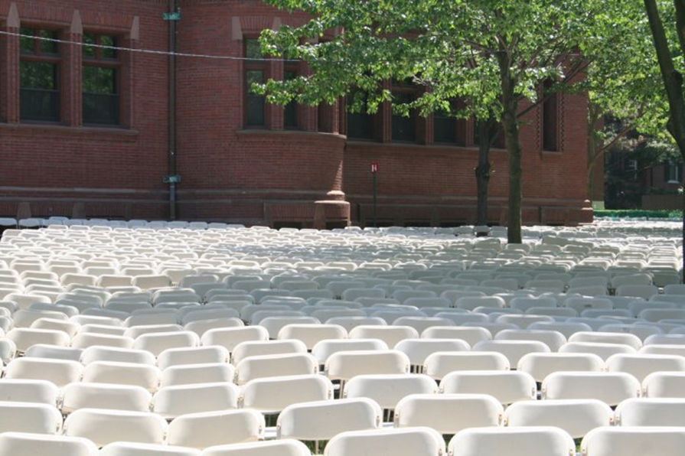
Thursday, May 30
6:45 a.m. Harvard Yard (Gates open for guests)
Ceremony simulcast under HGSE tent in Radcliffe Yard starts at 9:00 a.m.

Slide 8

Backpacks
“No backpacks of any type will be admitted. No bag or item larger than 12” x 12”x 12” will be permitted inside the Yard.” - HUPD

Slide 9

Strollers
Strollers are not allowed inside Tercentenary Theatre.

Slide 10
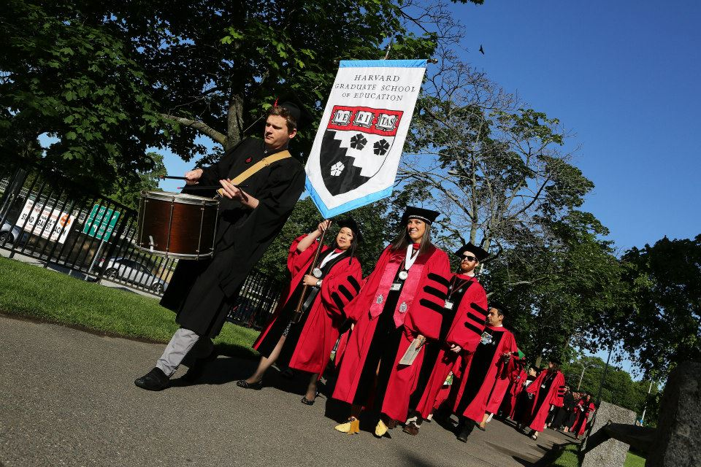

Thursday, May 30
HGSE Academic Processional
7:30 a.m. Appian Way
No children allowed to process into Tercentenary Theatre

Slide 11
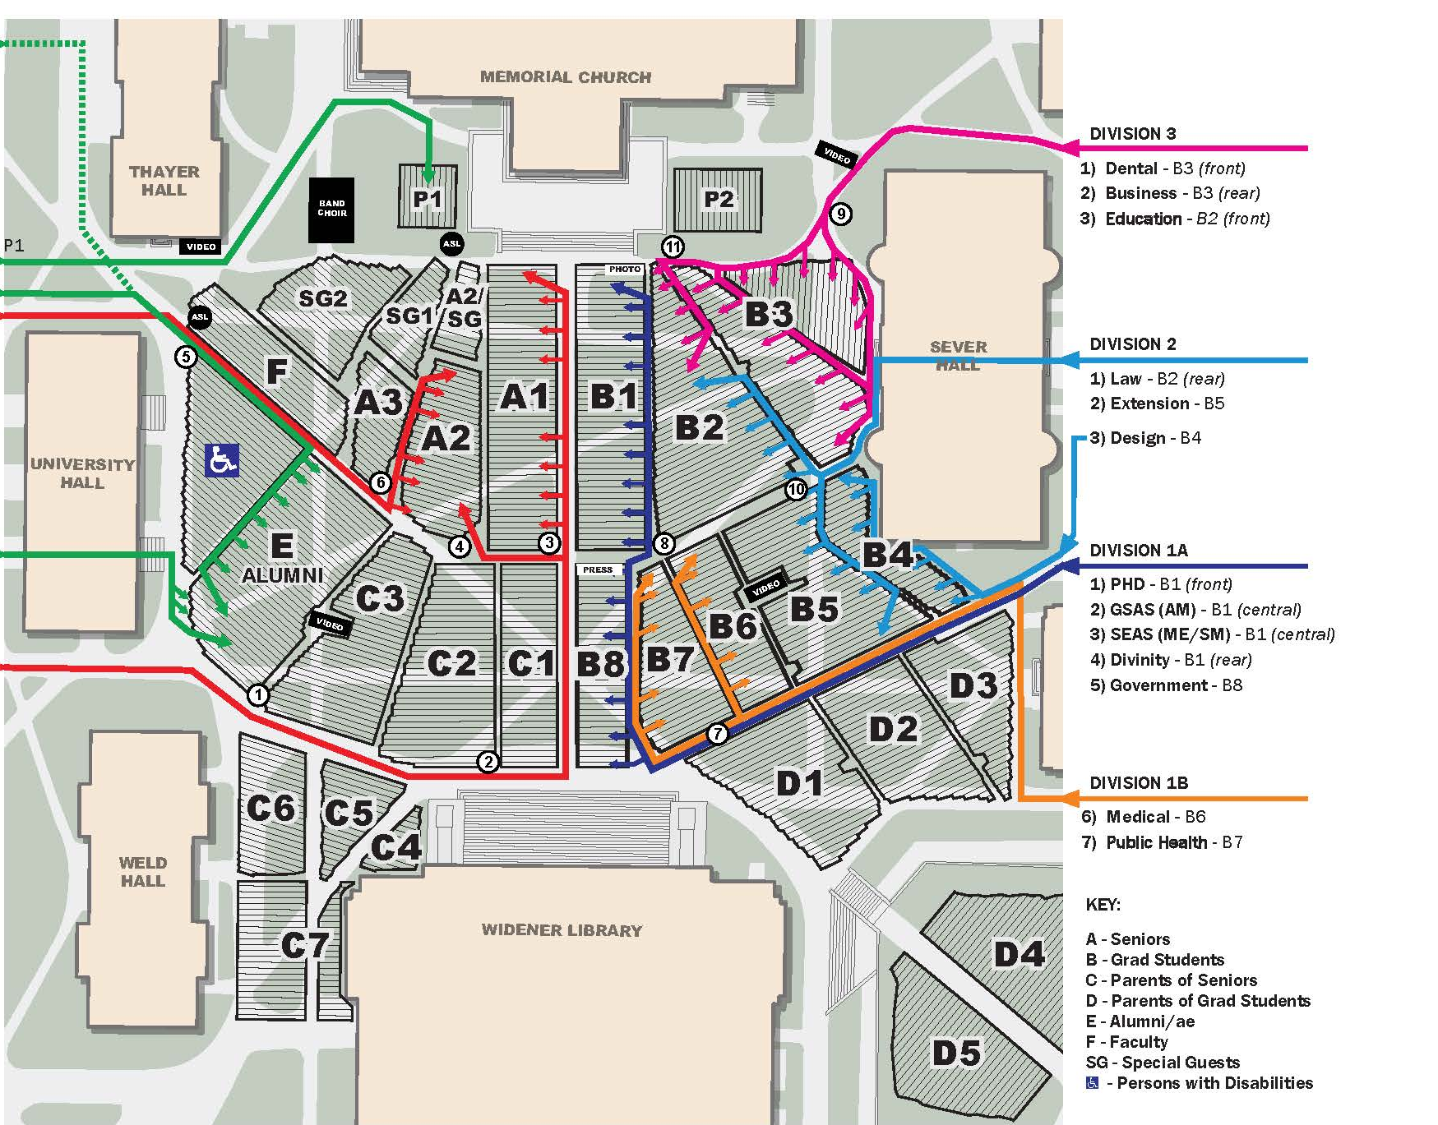
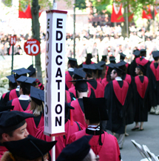
Tercentenary Theatre

Slide 12
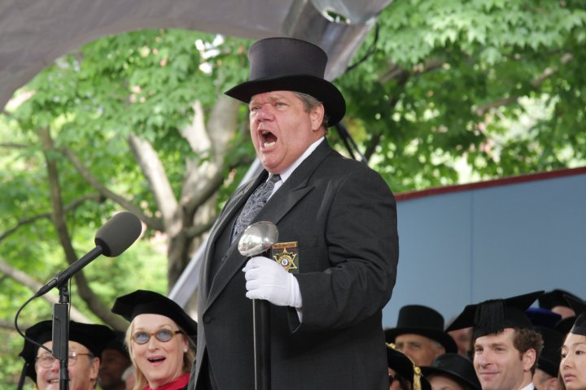
Entrance to Harvard Yard
Appropriate Regalia: Robe, hood, cap.
Lanyard.
Harvard ID

Slide 13
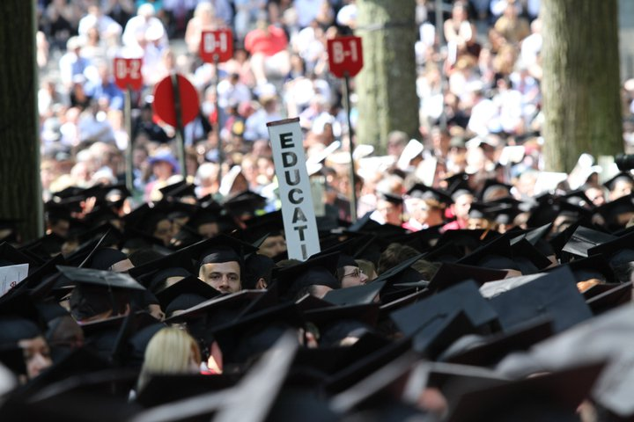
Morning Exercises
9:45 a.m. Harvard Yard
Student orators deliver speeches
Deans introduce the candidates
*Diplomas are not awarded here

Slide 14
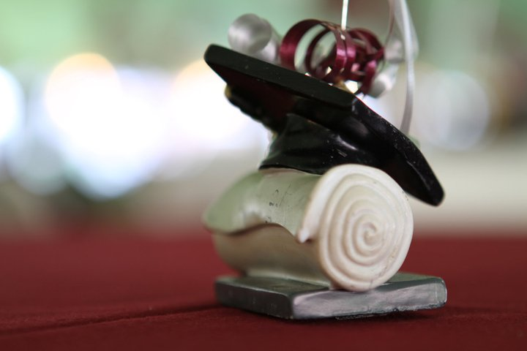
HGSE Diploma Ceremony
It is important that you return to HGSE, as quickly as possible, in order for our Diploma Ceremony to start on time.
*No tickets required

Slide 15
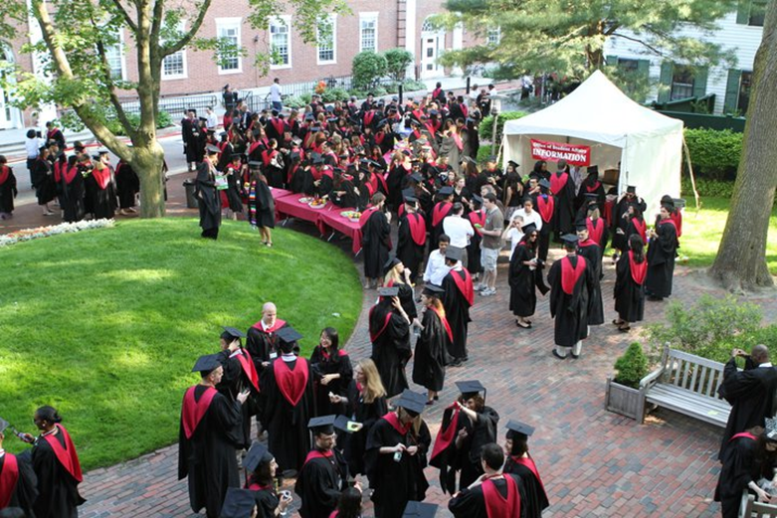
Meeting Locations
11:45 a.m. – 12:15 p.m. HGSE Campus
There will be signs posted on Appian Way, Longfellow Hall and Gutman Library

Slide 16
Meeting Locations
EAT: Food will be available
Use the restroom
Line-up in alphabetical order
*You will not return to the meeting
locations (they will not be locked)
do not leave any personal items behind.

Slide 17
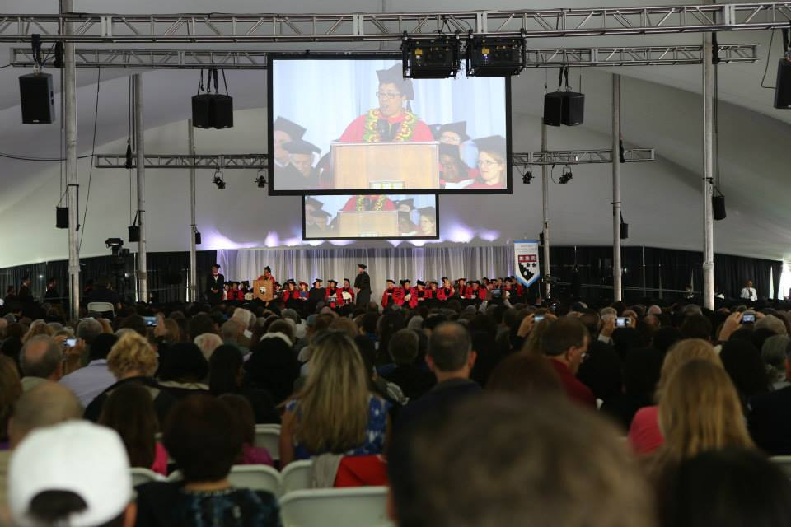
HGSE Diploma Ceremony
Guests may begin sitting under the tent at 9 a.m.

Slide 18
Processional
12:30 p.m. Radcliffe Yard
Graduates will process in alphabetical order.
Dean Long’s Address
Presentation of diplomas

Slide 19

Photos
Students may purchase professional photos; Commencement Photos, Inc. will mail information directly.

Slide 20

University Alumni Exercises
2:30 p.m. Harvard Yard
Alumni procession
Address by President Bacow
Commencement speaker Angela Merkel

Slide 21
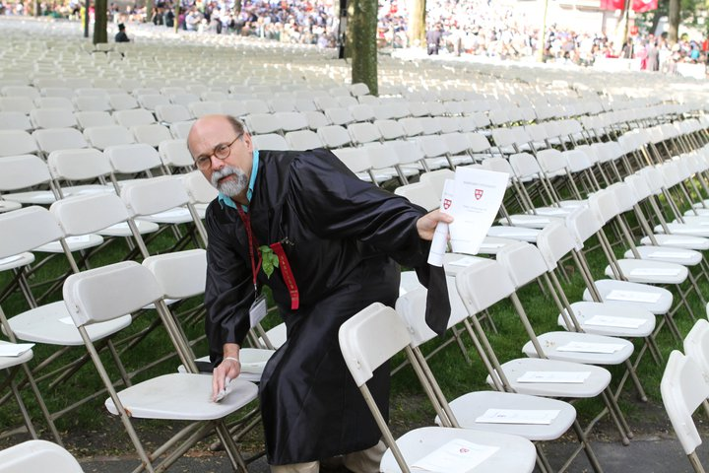
Tips!
Commencement happens, rain or shine.
The dye from regalia may bleed.
Wear comfortable shoes.
Be on time!

Slide 22
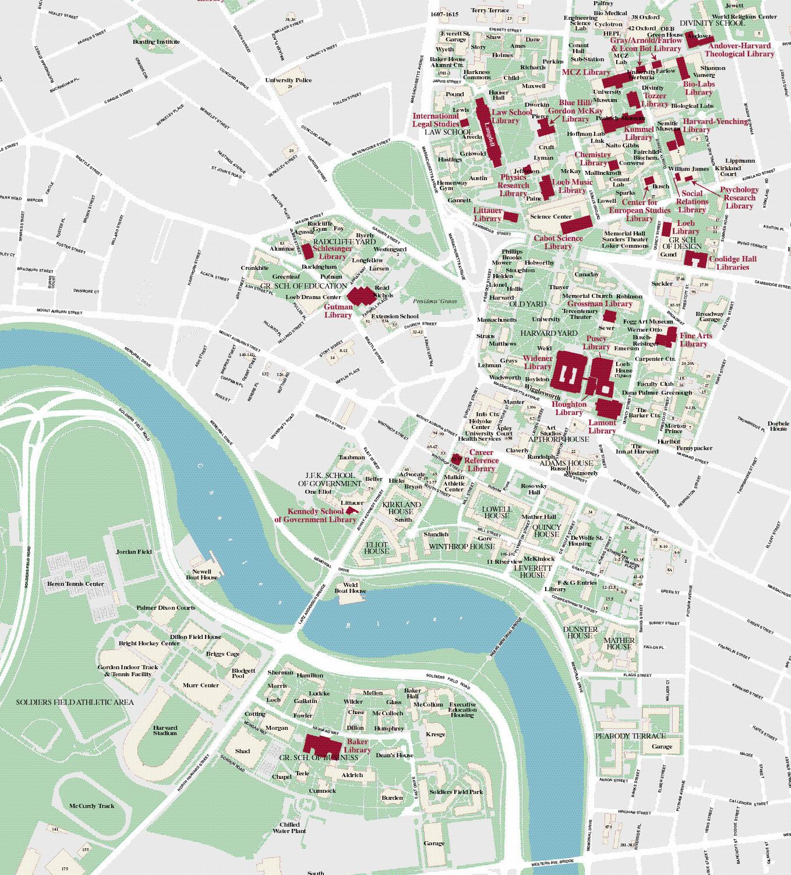

Parking
Available from 6:30 a.m. Wheelchair lift-equipped shuttles will be running until 8:00 p.m.
Harvard University Parking Services
Smith Campus Center 8th Floor
parking@harvard.edu
617-495-3772

Slide 23

Access & Disability Services
Students must request accommodations for both University and HGSE events, as part of the ticket
ordering poll.

Slide 24

Wheel Chairs
Belmont Medical Supplies
www.belmontmedical.com
185 Belmont St
Belmont, MA 02478
(617) 484-3888

Slide 25
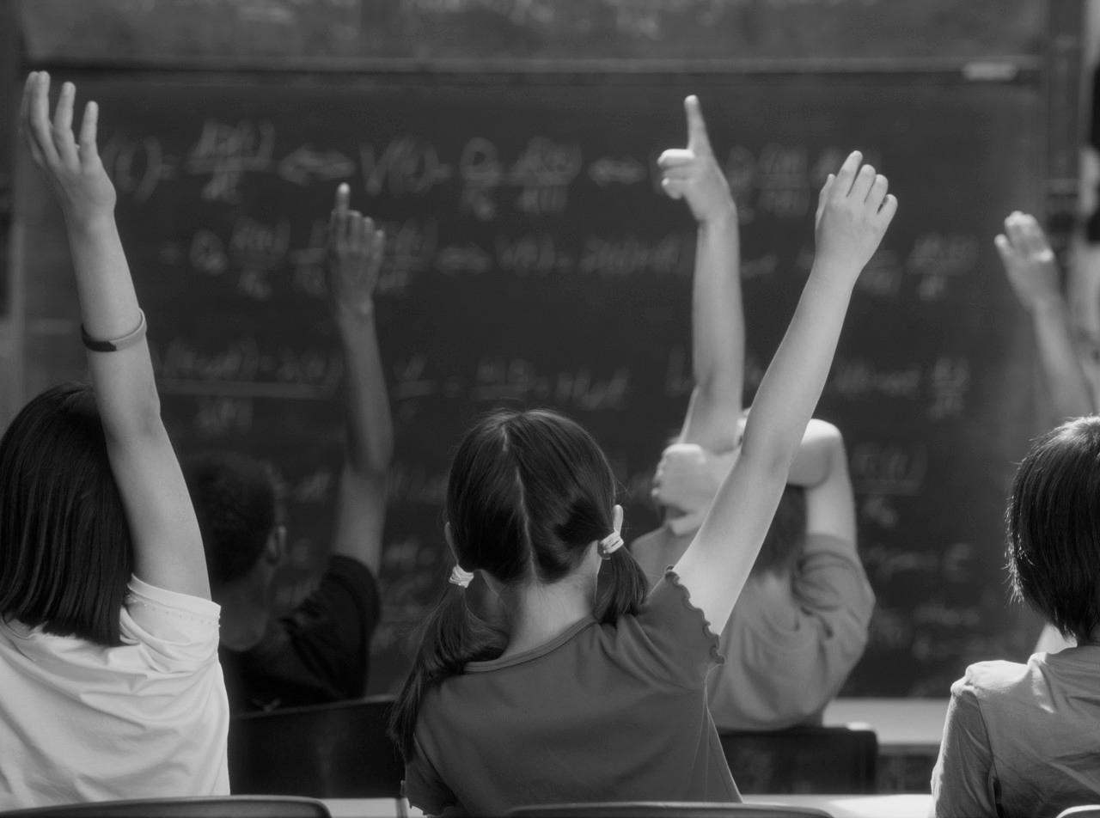
Questions?
Office of Student Affairs
Commencement website
HGSE Weekly Newsletter
osa@gse.harvard.edu
617-495-8035

Slide 26
