Slide 1


Housing Information
Office of Student Affairs

Slide 2
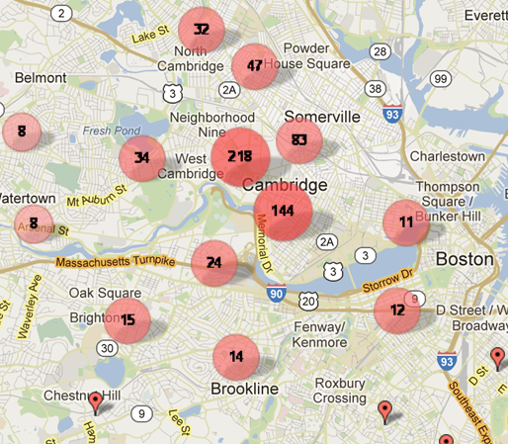
Where do HGSE Students Live?
∙ Cambridge
∙ Somerville
∙ Medford
∙ Belmont
∙ Watertown
∙ Allston
∙ Brookline
∙ Brighton
∙ Everywhere!

Slide 3

How much does it cost to live
in the Cambridge/Boston Area?
Rent in the Cambridge/Boston areas can range from $933/month for a room in a shared apartment to $5,967/month for a 3-bedroom apartment + utilities.

Slide 4

Types of Housing
Harvard University Housing (HUH)
Cronkhite Residence Hall (part of HUH)
GSAS Residence Halls
Private Rentals

Slide 5
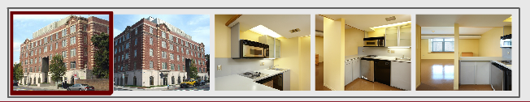
Harvard University Housing
Main application season: March 1 – May 1
$1,716/month (studio) - $5,364/moth (3-bedroom)
Lease start dates vary - usually July 1 - June 30
All utilities included
Monthly payment: check, credit card, student bill
No last month’s rent, security deposit, or “finder” fees

Slide 6
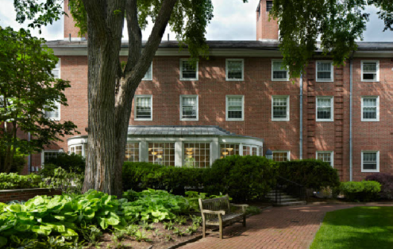
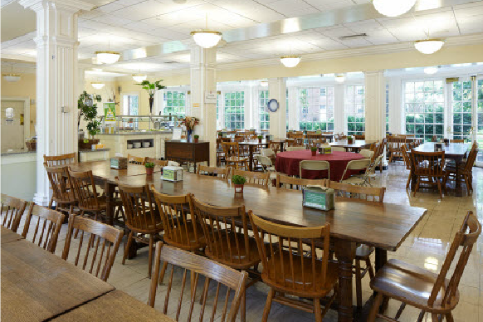
Cronkhite Graduate Center
(part of HUH)
Single students only (120 rooms)
July 1 – June 30
Rate: $1,206 - $1,578 (per month) + $6,610 mandatory meal plan.
Term billed and monthly options
Applications March 1 - May 1

Slide 7
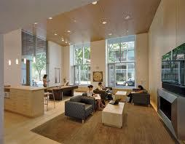
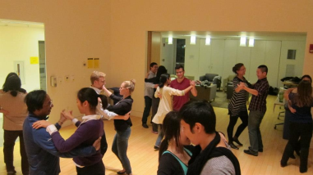
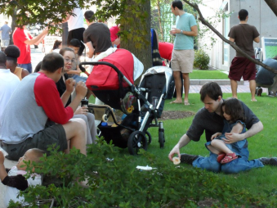
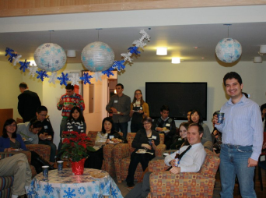
Graduate Commons @ HUH
Interdisciplinary, community-based program for Harvard graduate students, faculty, staff, and their families living in HUH properties

Slide 8
HUH View & Select Process
Applications submitted (March 1 - May 1) are randomly assigned view & select dates in early May
On your "View" date you can see details about available units; you can only choose a unit on your “Select” date
Once you select a unit, HUH will email lease documents to you within two business days
Questions? email leasing@harvard.edu or call 617.495.1459
Each select window has approximately 400 applicants

Slide 9
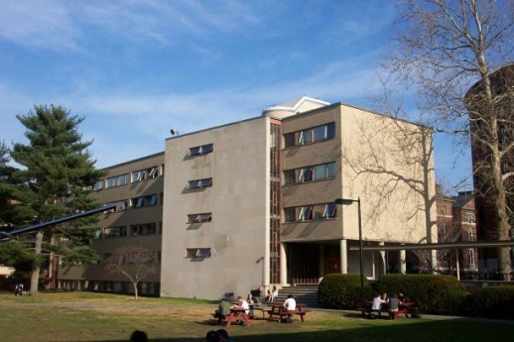
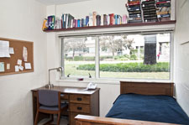
Graduate School of Arts & Science (GSAS) Residence Halls
Single students only (20 rooms)
August 23, 2019 - May 22, 2020
Rate: $7,402 - $11,622 (per academic year) + $2,426 mandatory meal plan
Term billed in two installments
Application deadline: May 1 (5 pm EDT)
Rooms are randomly assigned via lottery

Slide 10

Applicants with Disabilities
and/or Special dietary needs
Apartments appropriate for individuals with a physical disability or medical condition are available + service animals.
Cronkhite & GSAS meal plans can accommodate students’ special dietary needs.
Please contact Maritza Hernandez ASAP
Maritza_Hernandez@gse.harvard.edu

Slide 11

Off-campus options

Slide 12
Private Rentals
Online classified ads on websites like harvardhousingoffcampus.com, padmapper.com*, boston.com*, etc.
Real estate agencies charge a "finder's fee" (usually one month's rent) + security deposit, 1st and last month’s rent.
*Please note that Harvard University and the HGSE do not endorse any of these services

Slide 13

Utilities
Monthly costs can be roughly estimated at $300/month
Gas, heat, and electricity
Water (usually included in rent)
Washer/Dryer (usually coin-operated)

Slide 14

On & Off-campus

Slide 15
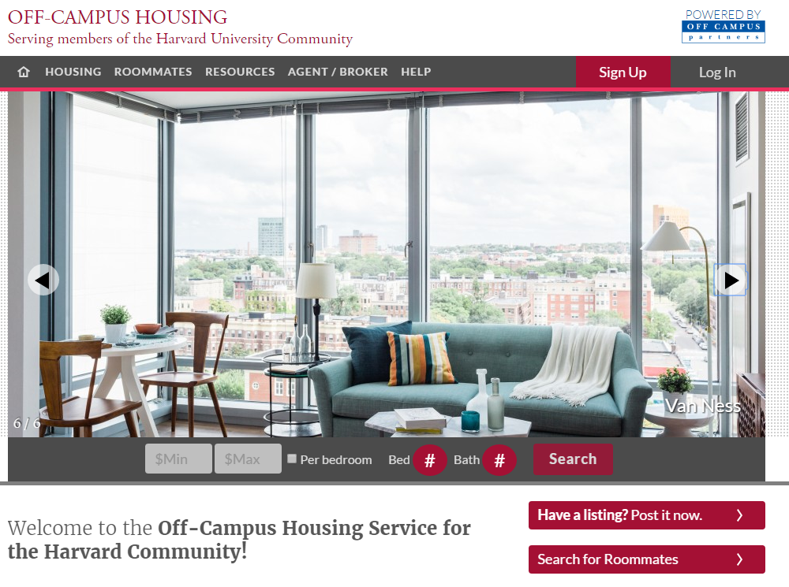
Roommates
Finding roommates can be a good way to reduce housing costs
harvardhousingoffcampus.com*
Boston.craigslist.org*
Facebook*
*Please note that HGSE does not
endorse these services

Slide 16

Signing a Lease
A lease is a binding legal contract (usually one year)
Health problems, roommate challenges, construction noise, etc. will not allow you to get out of a lease.
Verbal agreements are
non-binding, make sure all
expectations are listed on lease

Slide 17

Lease Rider
A lease rider is an addition to the lease indicating a specific condition, for example, a construction project taking place during the lease term.

Slide 18

Harvard University Parking
Students may rent a space from the University parking office ($1,650.00+/year)
Parking Questions:
parking@harvard.edu
617.496.7827

Slide 19

Cambridge Parking
Parking in Cambridge is by permit; you must register your vehicle in Massachusetts (subject to state tax and local insurance rates).
Apartments usually do not include parking; if advertised, make sure it is stated on the lease.

Slide 20
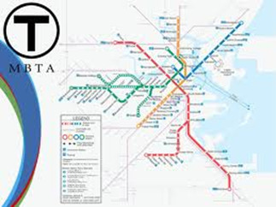

Public Transportation
MBTA bus and subway “the T”
Discounted semester passes available for HGSE students

Slide 21

Can I bring my pet?
A limited number of HUH properties allow pets
  *Please contact HUH for complete rules & regulations
Make sure your lease/landlord clearly grants permission to have pets

Slide 22
Contact Information
Harvard University Housing (Including Cronkhite):
General questions: huhousing@harvard.edu; 617.496.7827
Application questions: housingapp@harvard.edu; 617.496.4449
Lease questions: leasing@harvard.edu; 617.496.1459
GSAS Residence Halls:
gsasreslife@fas.harvard.edu; 617495.5060

